Slide 1
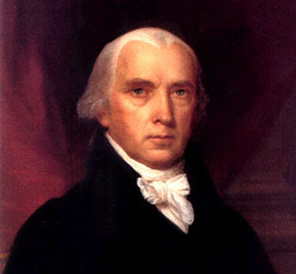
James Madison helped created many of the compromises that made the Constitution possible & is referred to as the “father of the Constitution”

Slide 2
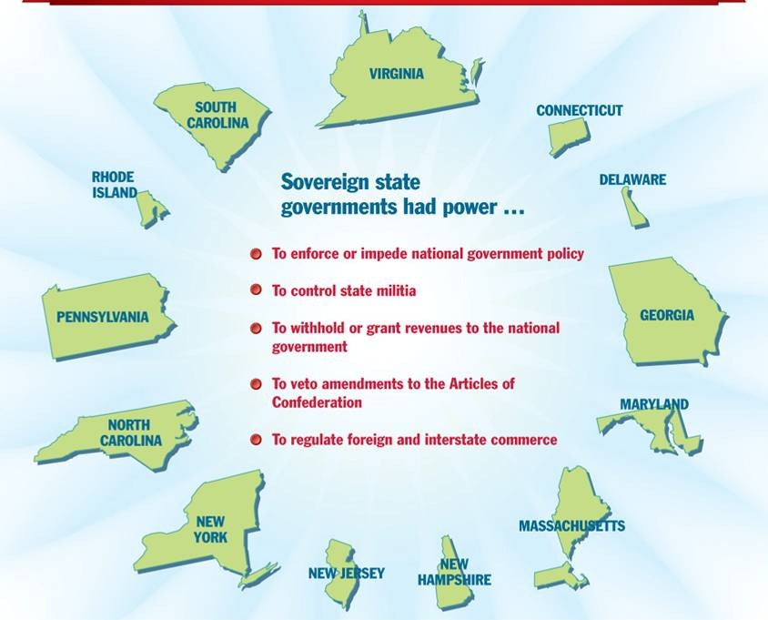
The Constitution was a radical shift from the Articles of Confederation because it gave more power to the national gov’t than to the state gov’ts

Slide 3
Key Ideas of the Constitution
Separation of Powers: the government will be divided into three separate branches.
Popular Sovereignty: the people have power by voting for leaders
Limited gov’t: even though the national gov’t was stronger, citizens’ liberty was still protected
Federalism: the national gov’t shares power with state gov’ts
Checks & Balances: safeguards exist to prevent one branch from having all power

Slide 4
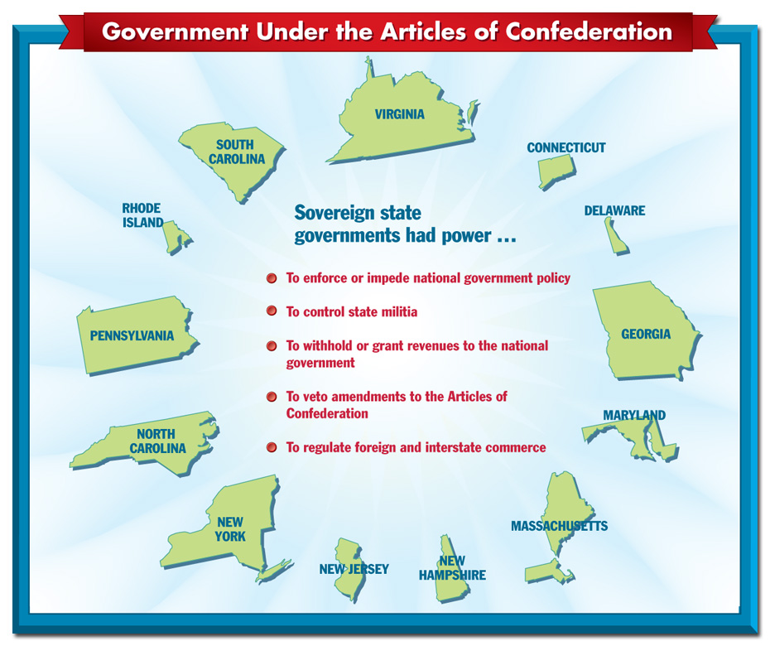
Federalism—state gov’ts & the national gov’t both have power
The supremacy clause establishes the Constitution (not the states) as the "the supreme law of the land"
A state law cannot contradict a national law

Slide 5
Key Ideas of the Constitution
Separation of powers: three branches with defined powers

Slide 6
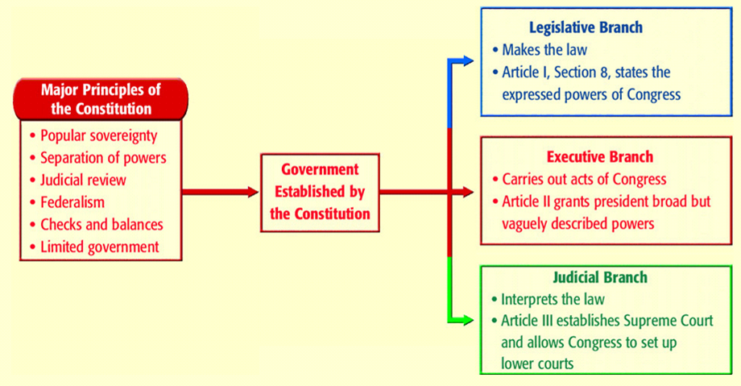
Separation of Powers

Slide 7
Article 1: Legislative Branch
Notes:
7

Slide 8
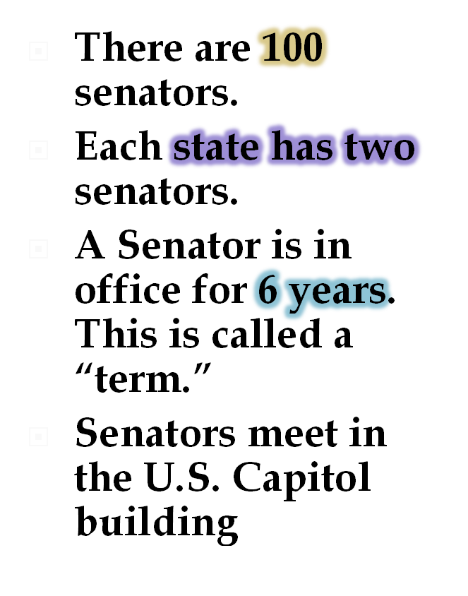
House of Representatives
Senate
Senators must be at least 30 yrs. old
Representatives must be at least 25 yrs. old
Notes:
8

Slide 9
Key Ideas of the Constitution
Only Congress can make laws, declare war, create taxes
The “elastic clause” gives Congress implied powers to make all laws seen as “necessary & proper”
The Senate ratifies treaties & confirms judges
Either side can start the process to make a law, but if it involves taxes it must start in the House.

Slide 11
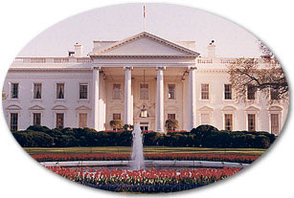
Article II: Executive Branch
Must be at least 35 yrs. old
The president, or Chief Executive, is the head of the government.
Serves 4 year terms.
After elected to serve his/her country, the president lives and works in the White House.
The president is in charge of the armed forces.
(Commander and Chief) The president works with leaders of other countries.
Notes:
11

Slide 12
Key Ideas of the Constitution
The president can only recommend legislation to Congress
Can veto bills, but Congress can override with a 2/3 vote in both sides.
The president can appoint judges to the Supreme Court and members to his cabinet (group of advisors), but the Senate must ratify those appointments!

Slide 13
Article III: Judicial Branch
The Supreme Court is the highest court is the U. S., and is the system of courts to settle questions about the laws.
The nine justices can serve for life, or wish to retire.
Each justice is chosen by the president and approved by the Senate
Notes:
13

Slide 14
Key Ideas of the Constitution
The only court mentioned in the Constitution is the Supreme Court

Slide 16
Article IV: Relations Among the States
States must have full faith and credit among each other
President has the power to move troops into any states to make sure law and order are followed
Criminals must be returned to the state where they committed a crime for trial
New States can only be added by Congress

Slide 18
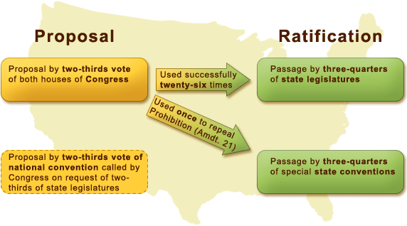
Article V: The Amendment Process
The Amendment Process allows for changes to be made – this makes the Constitution a “living document.”
We have 27 amendments to the Constitution (first 10 are the Bill of Rights)
Amendments must pass 2/3 of BOTH Senate and the House, then must be ratified by 3/4 of all states

Slide 19
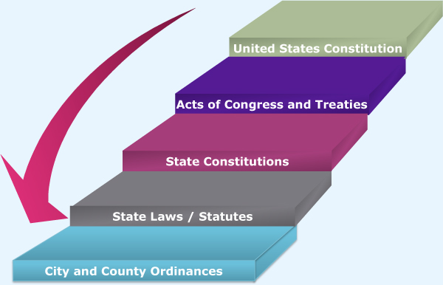
Article VI: National Supremacy
The supremacy clause establishes the Constitution (not the states) as the "the supreme law of the land"
A state law cannot contradict a national law!
No religion test shall ever be done as a requirement for public office

Slide 20
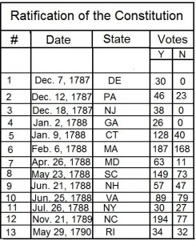
Article VII: Ratification of the U.S. Constitution
The Constitution required approval of 9 of 13 states to be adopted

