Slide 1
I. The Articles of Confederation: The First Plan of Government of the United States

Slide 2
The Articles of Confederation:
What did it do well? Organize Territory!

Slide 3
So, did the Articles do anything that was good? Organize territory!
After the revolution, the United States received a lot of land that was previously occupied by Britain.
The Articles of Confederation passed two laws to help organize this territory:
Notes:
12

Slide 4
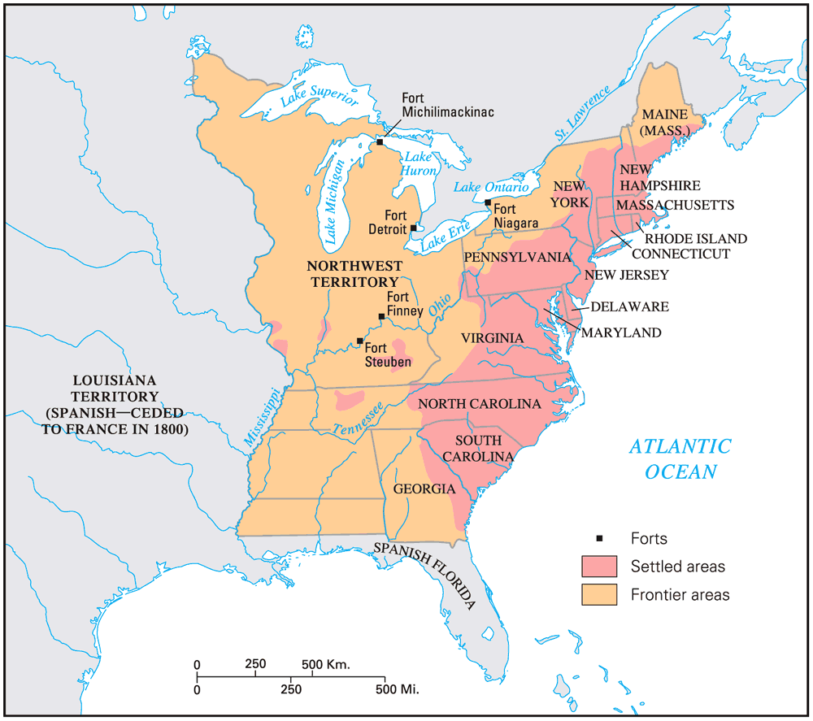
The United States, 1783
The USA in the “Critical Period”

Slide 5
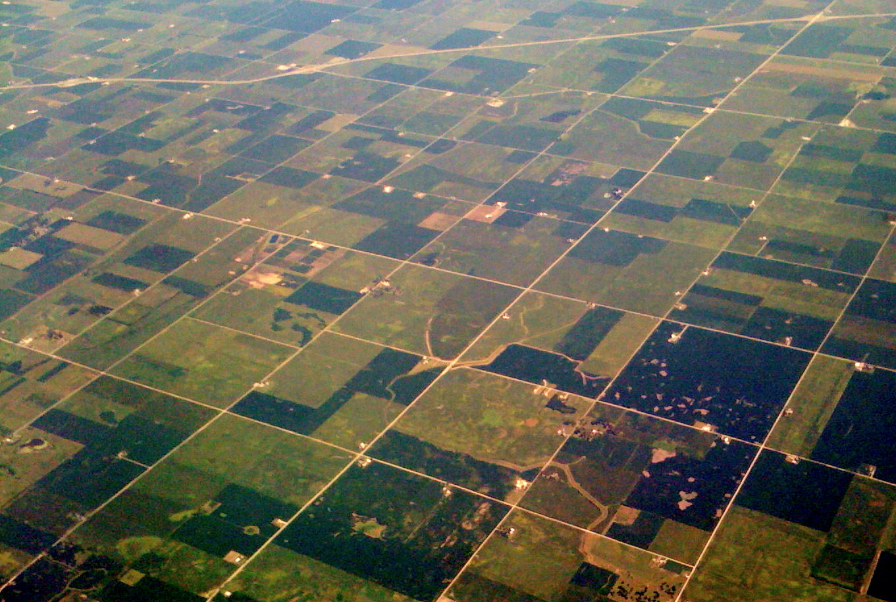
What do you notice in this aerial view?
THIS was created by the Land Ordinance!

Slide 6
The Land Ordinance of 1785
The U.S. gov’t was eager to sell off Western lands to settlers to gain revenue (since the gov’t did not have the power to tax)
Established an orderly process for laying out western townships
6 mile by 6 mile sections (36 square miles). Townships also had 36 “lots”
Some lots could be sold as is, some could be broken into parts.
Section 16 of the each township was dedicated to public schools
Notes:
13

Slide 7
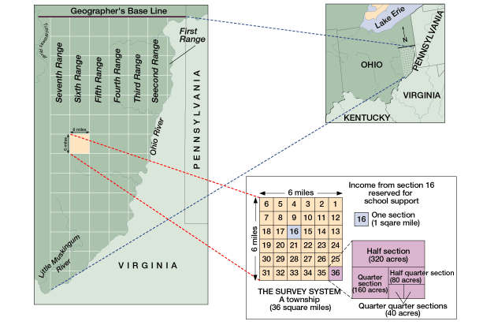

Slide 8
The Northwest Ordinance
The Northwest Ordinance (1787) gave structure to the NW territory:
Created new territories and future states of OH ,MI, IN, IL, WI
Residents could apply for statehood with 60,000 people
Slavery outlawed in NW lands
First attempt to address the issue of slavery!
Notes:
13

Slide 9
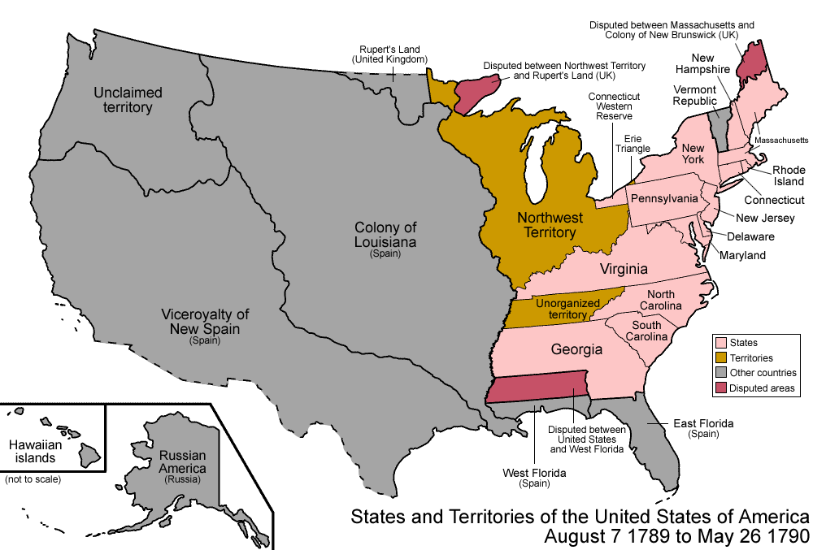
The United States, 1783
Because of the 1785 & 1787 ordinances, the Northwest territories were well organized & orderly
Prospectors poured into Kentucky & Tennessee
By 1790, the region was plagued by land claims & counterclaims that generated lawsuits for years
The USA in 1787
Territories south of the Ohio River received less attention from Congress

Slide 10
IV. The Articles of Confederation: The Final Straw

Slide 11
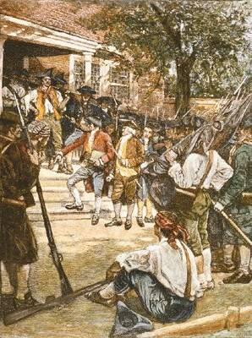
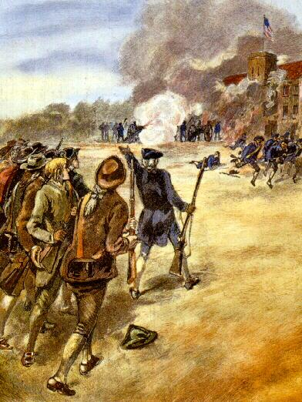
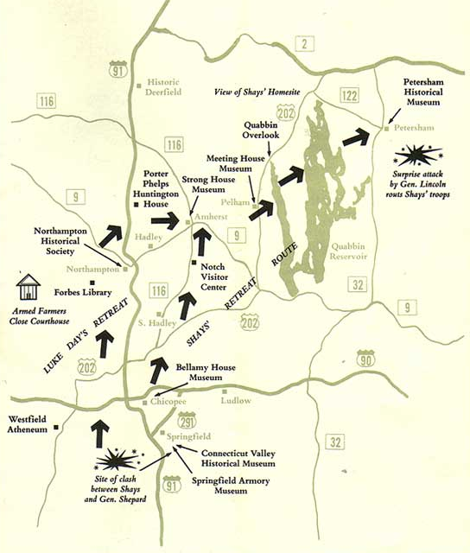
Shay’s Rebellion in Western Massachusetts
Government could not force states to pay taxes, therefore it could not pay soldiers
- Daniel Shays served in Rev War and had his farm seized because he had not paid his taxes, but he wasn’t paid by gov’t for his service
- He led an uprising that seized federal arsenal; eventually squashed, but it showed the failures of the new gov’t.
Country was not strong enough to prevent ordinary citizens leading dangerous rebellion.
This was the event that urged founders to create the Constitutional Convention

Slide 12
Conclusions
The Articles of Confederation accomplished exactly what its framers intended:
A weak government ensured nobody could seize control, but it also made government very ineffective.
The U.S. needed a stronger central government, but with safeguards to prevent someone from becoming too powerful.

Slide 13
“Have We Fought for This?”
“Have we fought for this? Was it with these expectations that we launched into a sea of trouble?”
—George Washington, 1785

Slide 14
V. The Debate Over A New Government

Slide 15
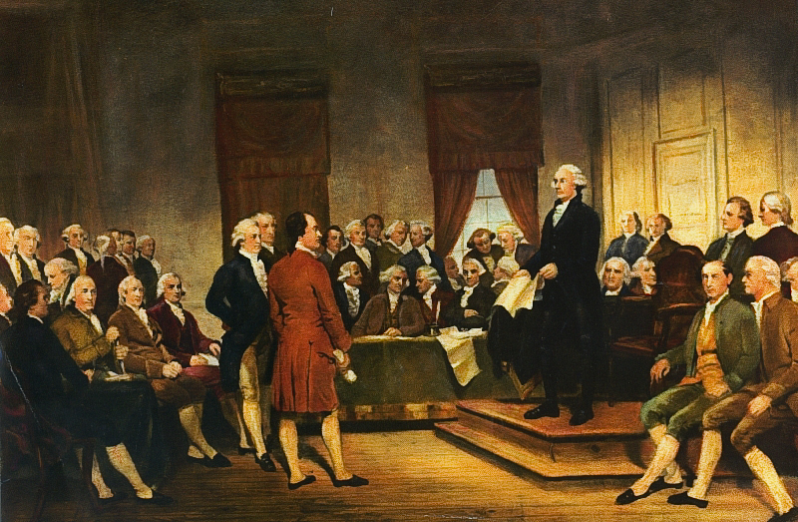
The Philadelphia Convention
In May 1787, 55 delegates from all states (except RI) met to discuss revising the Articles
of Confederation,
but it soon became
apparent that something more
serious was needed
Delegates elected George Washington to preside over Convention.
They did NOT intend to replace the Articles
Notes:
19

Slide 16
Inventing a Federal Republic
Delegates incorporated 4 major principles into this new gov’t:
Limited gov’t—even though government will have more power, it still must have limits!
Republicanism—the people vote for their leaders
Separation of powers—three branches with defined powers
Federalism—the national gov’t shares power with state gov’ts
Notes:
21

Slide 17
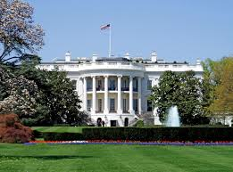
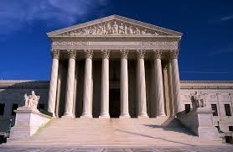
Everyone agreed that the new government will have 3 branches:
But, there was great disagreement over how states would be represented in the legislative branch.
Notes:
21

Slide 18
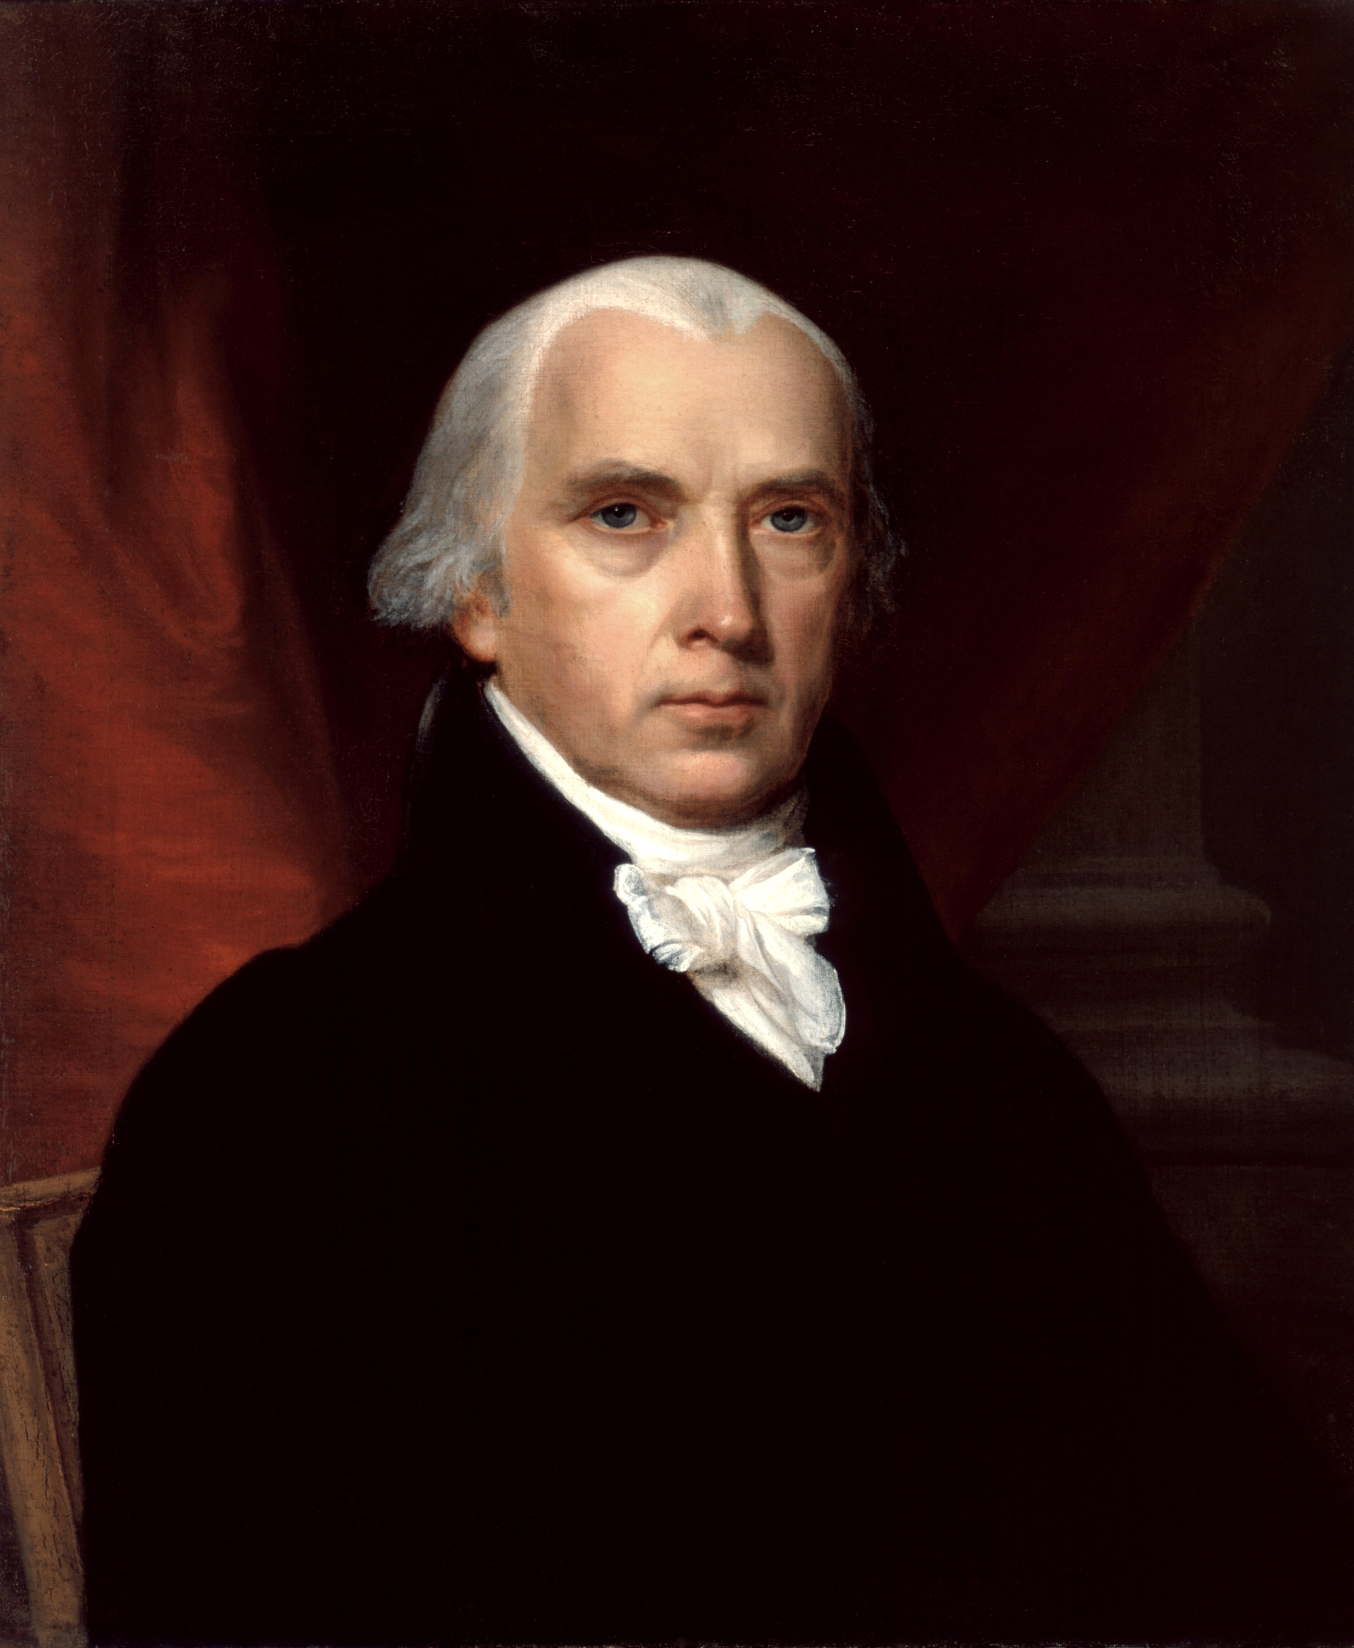
Large states favored Virginia Plan
Created bicameral legislature
State are represented based on their population
Proposed by James Madison, the “father of the Constitution.”
Thoughts from the small states?

Slide 19
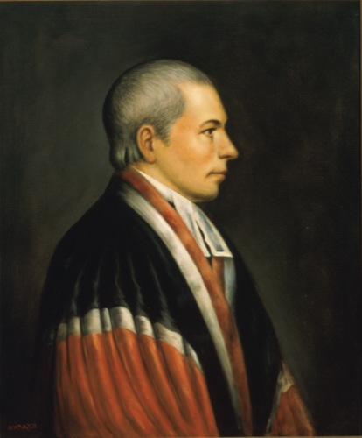
Smaller states favored New Jersey Plan
Keep unicameral legislature of Articles
All states should be represented equally
Proposed by William Paterson.
A state is a state: population should not matter!

Slide 20
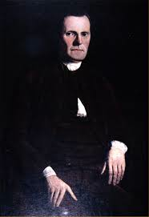
The Deal? The Great Compromise
Also called the Connecticut Compromise.
Created a bicameral legislature.
Proposed by Roger Sherman.
This compromise both large and small states!

Slide 21
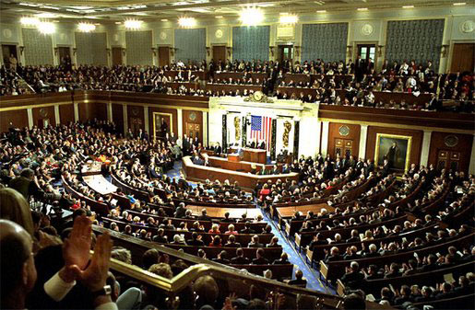
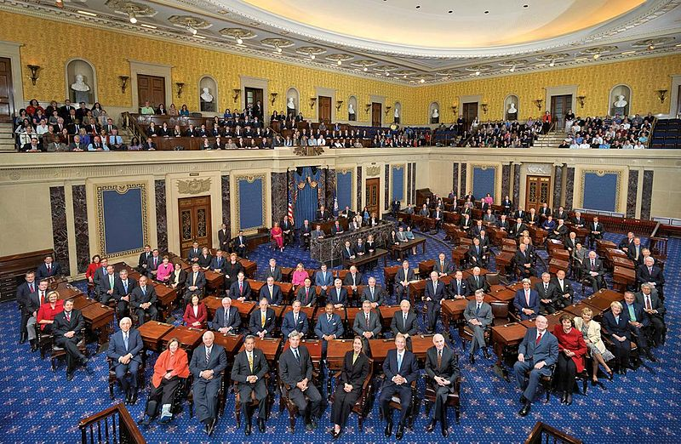
The Great Compromise
House of Representatives
The Senate
- states receive representation (votes) based on their population
- favors largely populated states
- All states represented evenly (2 senators for each state)
- Favors smaller populated states
Q: Which branch is more reflective of the American people? Why?

Slide 22
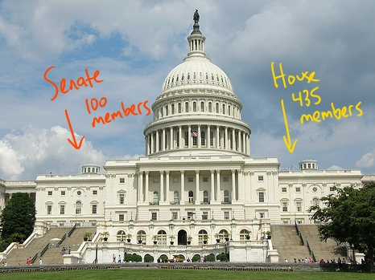
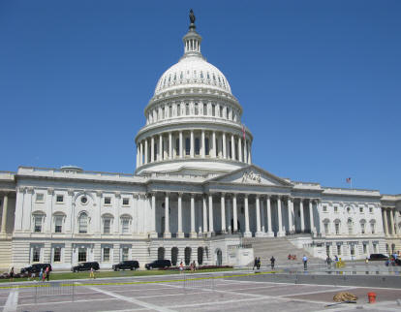
The House’s 435 members are on the right side of the capital…
The Senate’s 100 members are on the left side of the Capitol…
Of course this is flipped when we walk behind the Capitol…

Slide 23
Now that the issue of HOW states will be represented in the new government is settled…

Slide 24
How will slaves count?
Southern states wanted to count their slaves as people, since it would give more representation in the House of Reps.
Northern states opposed counting slaves.
If south can count property, can we?
What was the deal? The 3/5 Compromise:
Slaves would count as 3/5 of a person (or for every 5 slaves, population will increase by 3 people.)

Slide 25
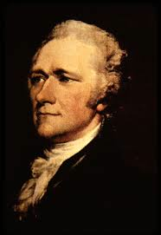
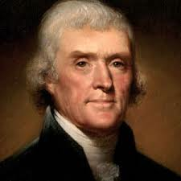
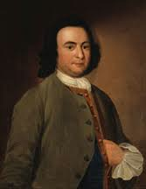
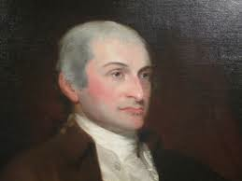
Now, it’s time for the states to vote! This is called ratification.
Supporters of the Constitution = FEDERALISTS
Used the Federalist Papers to argue the government needed to be stronger!
Against the Constitution =
ANTI- FEDERALISTS
Believed Constitution placed too much power in gov’t; favored the elite
Alexander Hamilton
Thomas Jefferson
James Madison
George Mason
After months of debate, Federalist and Anti-Federalists finally reached a solution…
John
Jay

Slide 26
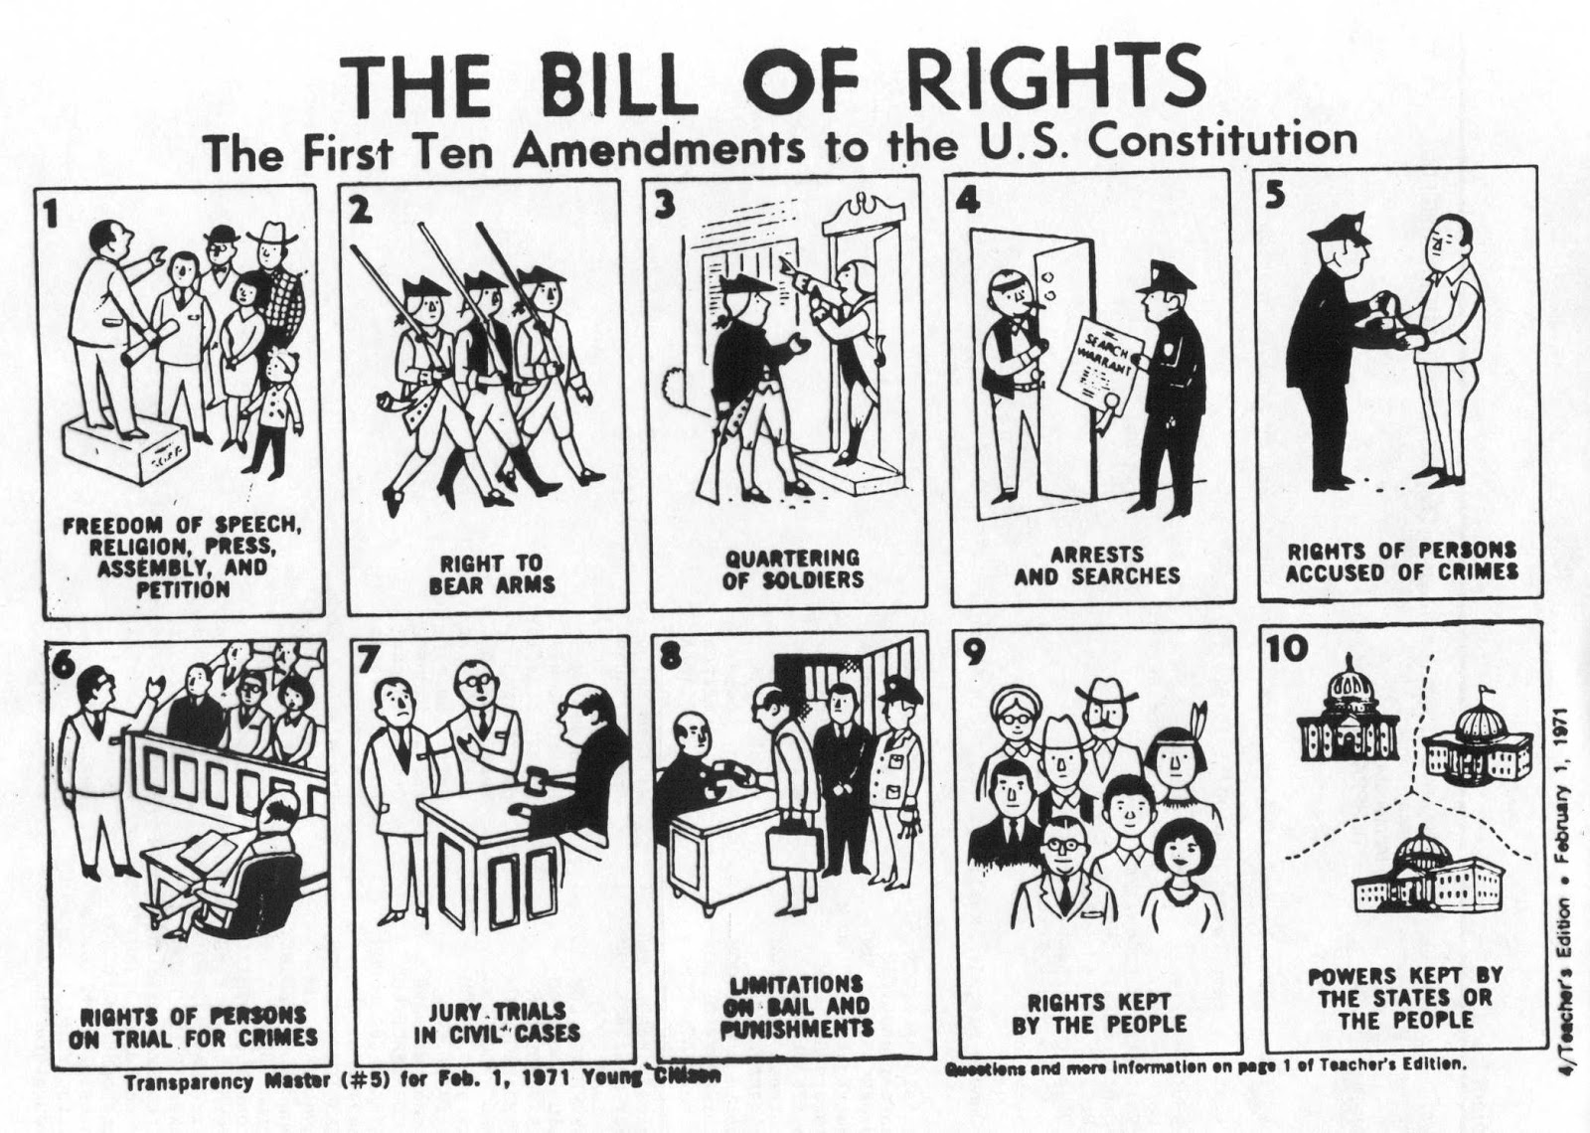
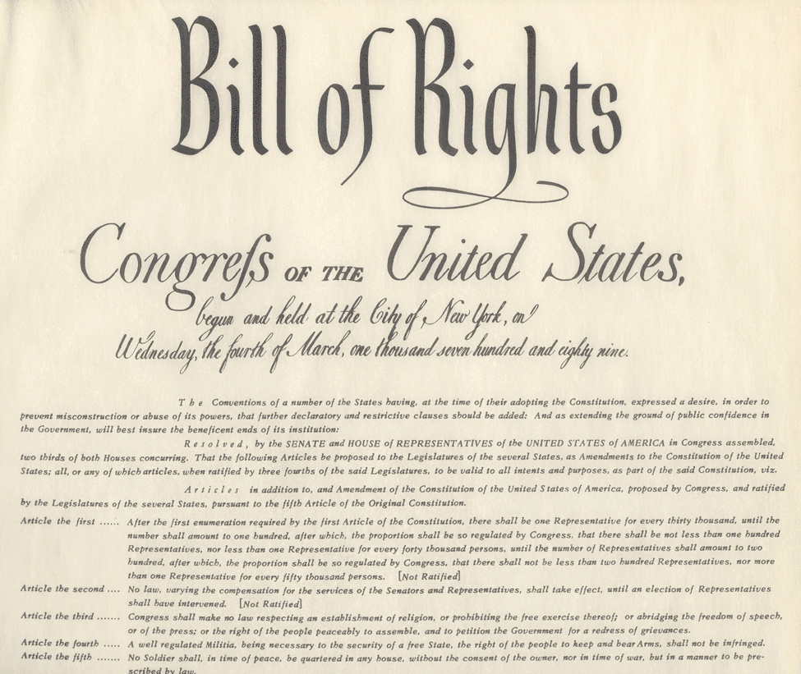
Anti-Federalists would support Constitution IF a Bill of Rights was added.
This is a list of rights and freedoms guaranteed to all people
This would guarantee gov’t could not become too strong
To satisfy Anti-Federalists, 10 amendments (or changes) are added to protect the people.

