Slide 1
Aim: How did Ancient Greek Civilization Develop?
Do Now: Write a response to the
following question,
“What does the dialogue tell you about
Ancient Greek civilization?”
Person A: “I am Greek, but I am also Spartan!”
Person B: “ I am also Greek, but I am Athenian”

Slide 2
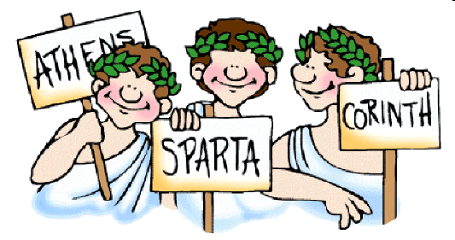
Polis
A City-state in Ancient Greece

Slide 3
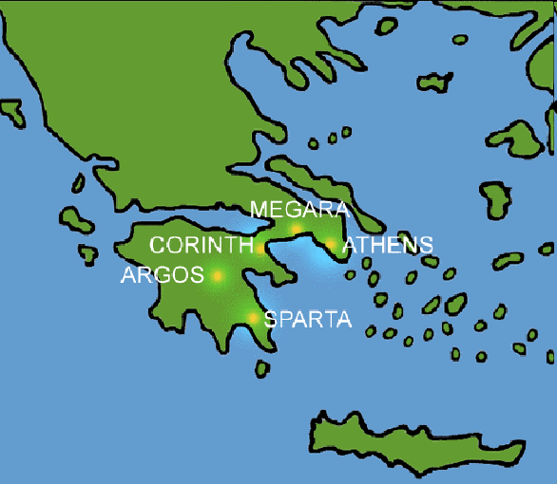
Polis
Each polis was a nation of its own
developed because land was isolated by mountains or water
common language
depend on one another to survive.
met every year at a great athletic contest known as the Olympics.

Slide 4
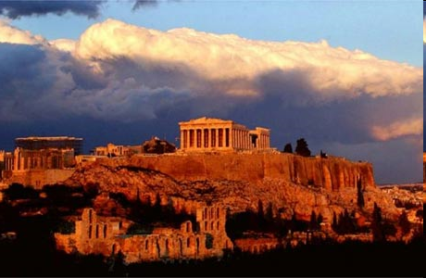
ACROPOLIS
a large hill in ancient Greece where city residents sought shelter and safety in times of war and met to discuss community affairs

Slide 5
Agora
A central area in Greek cities used both as a marketplace and as a meeting place.

Slide 6
To be a citizen of a city-state
The ancient Greeks referred to themselves as citizens of their individual city-states.
Each city-state (polis) had its own personality, goals, laws and customs. Ancient Greeks were very loyal to their city-state.
The city-states had many things in common.
All believed in the same gods.
Spoke the same language.
Ancient Greeks were extremely loyal to their city-state
Greeks would not say, "I live in Greece."
They would say, "I am a Spartan.” or "I am Athenian."
The city-states might band together to fight a common foe. But they also went to war with each other.
Ancient Greece was a collection of Greek city-states.

Slide 7
Because Greece was not yet one country, there was no central government in ancient Greece.
Each city-state had its own form of government.
Some city-states, like Corinth, were ruled by kings. Some, like Sparta, were ruled by a small group of men. Others, like Athens, experimented with new forms of government.

Slide 8
Types of Government
Four Forms of Government
Monarchy: Rule by a king
Oligarchy: Rule by a small group
Tyranny: Rule by a dictator
Democracy: Rule by the citizens,
voting in an assembly

Slide 9
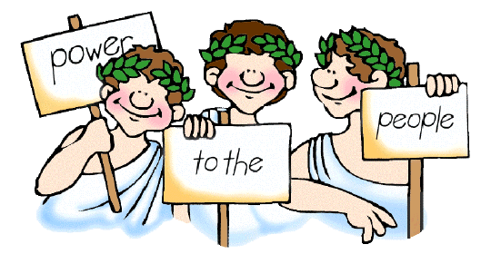
Athens
Athenians thought of themselves as the shining star of the Greek city-states. They were famed for their literature, poetry, drama, theatre, schools, buildings, and government.
Athens started as a small village, home to a tribe of Ionian people. It grew rapidly until Athens was one of the two most powerful city-states in the ancient Greek world. Athenians were famed for their commitment to the arts and sciences.

Slide 10
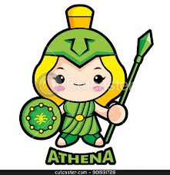
The Greeks believed that each city-state in ancient Greece had a god or a goddess in charge of it, their special patron.
For Athens, the patron was Athena, goddess of wisdom.
Therefore, Athenians put a
great deal of emphasis on education.
Most Greek city-states were ruled by kings. The men of Athens experimented with government. For about 100 years, Athens was a direct democracy!

Slide 11
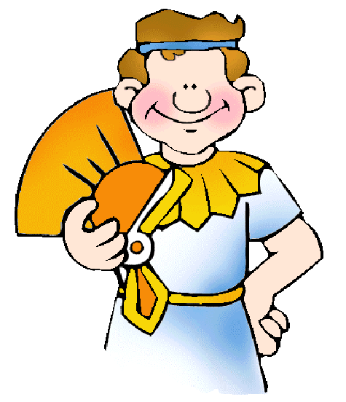
Direct Democracy - A government in which people vote to make their own rules and laws
Representative Democracy - A government in which people vote for representatives. The representatives make rules and laws that govern themselves and the people.

Slide 12
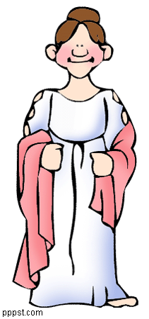
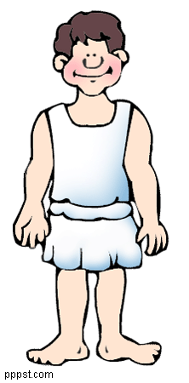
Education in Athens
Boys were educated quite differently.
Until age 6 or 7, boys were taught at home by their mothers.
From 7-14, boys attended a day school outside the home, memorizing Homeric poetry, learning to play the lyre, drama, public speaking, reading, writing, and math.
After, they went to a four year high school and
learned more about math, science, and government.
At 18, they attended two years of military school.
Girls learned at home from their mothers.
Learned how to run a home, and how to be good
wives and mothers.

Slide 13
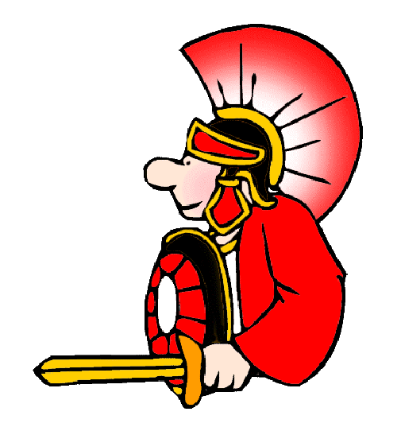
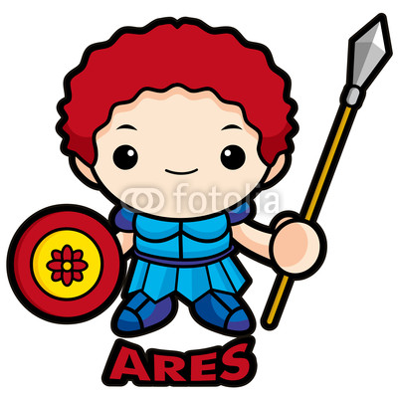
Sparta
Sparta began as a small village of Dorian people. The Dorians were warriors. So were the Spartans. Spartans endured unbelievable pain and hardship to become a superior Spartan soldier and citizen!
Sparta's government was an oligarchy. The people were ruled by a small group of warriors. The Spartans spoke Greek, wrote Greek, thought of themselves
as Greeks, but they were very different
from the other Greek city-states,
and proud of it.
Sparta’s patron was Aries – god of war

Slide 14
As adults, men did not live with their families. They visited their families, but men lived in soldiers barracks.
Women, unlike women in the rest of Greek world, had a great deal of freedom.
Women were educated to be fighters. Some women became warriors. Many ran businesses. They were free to move about.
Life was very different in ancient Sparta than it was in the rest of ancient Greek city-states. The Spartans were proud, fierce, capable warriors. No great works of art came out of Sparta. But the Spartans, both men and women, were tough, and the Greeks admired strength.

Slide 15
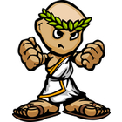
Education in Sparta
Sparta’s educational system was certainly very different.
The goal of Spartan education was to create a strong warrior.
Boys were taken away from their parents at age 7.
They lived a harsh and often brutal life in the soldiers barracks.
Younger children were beaten by older children to help make the younger boys tough and strong.
Children were often were whipped in front of groups of other Spartans, including their parents, but they were not allowed to cry out in pain.

