Slide 1
Bill
of
Rights
Scenarios
Objective: I can analyze the Bill of Rights.
Directions-Read each scenario. Decide if it violates any of the Bill of Rights. If it does, then identify which part of the amendment(s) the scenario violates.

Slide 2
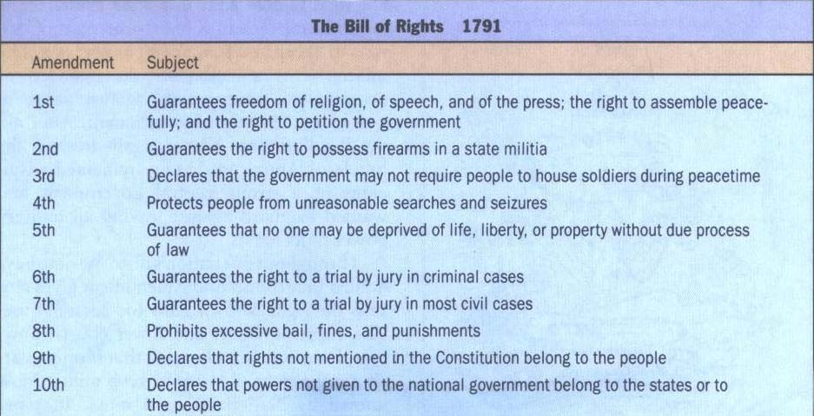
Bill
of
Rights
Scenarios

Slide 3
Scenario 1
Sara, an eighteen-year
is arrested for stealing paper and selling it on she appears before the
old college student,
a classmate’s term
the Internet.
When
judge, she asks for
a lawyer to help defend her. The judge
tells her if she is smart enough to be in
college, she is smart
herself. Besides, she with a felony, so the high
enough to defend
is not being charged stakes are not very

Slide 4
VIOLATION OF THE
AMENDMENT
6th
Guarantee of the Right to Counsel.

Slide 5
Scenario 2
A neighbor is suing the Joneses because a tree in the Joneses’ yard fell on their roof during a hurricane. The neighbors want the Jones family to pay $850 to have their roof repaired. Mr. Jones requests that a jury be present to hear this case. The judge says it is not necessary since the amount of the repairs is is so small. The Jones family
lives in Washington D.C.

Slide 6
VIOLATION OF THE
AMENDMENT
7th
Guarantee
civil cases
District of
of right to a jury trial
in
in federal court (and the
Columbia is under the
jurisdiction of a federal court).

Slide 7
Scenario 3
Carolyn is arrested for shoplifting a candy bar from a neighborhood convenience store. At trial, she is found guilty. The judge decides that the appropriate punishment is to cut off Carolyn’s hands so that she will not be able to shoplift again.

Slide 8
VIOLATION OF THE
AMENDMENT
8th
Guarantee of freedom from cruel
and unusual punishment

Slide 9
Scenario 4
Mr. Reynolds, an avid hunter, opens the door of his home one day to find agents from the Bureau of Alcohol, Tobacco, and Firearms outside. They inform him that certain provisions of a new federal law allow them to confiscate his rifles so that he may not engage in terrorist activities or plot against the United States government. They have no evidence that he is
connected to any such activities.

Slide 10
VIOLATION OF THE
2nd,
4th
&
5th AMENDMENTS
Guarantee of the right to keep and
bear arms, illegal search and seizure, and a violation of the guarantee of due process

Slide 11
Scenario 5
Your science teacher asks the class to exchange papers to correct last night’s homework. Your friend, Jamie, refuses to do so and is sent to the principal

Slide 12
NO VIOLATION
In Owasso Independent School
District v. Falvo (2001), The Supreme Court ruled that peer grading of student papers is not
a
violation of personal liberty or of
privacy

Slide 13
Scenario
Jesse, a fourteen-year old to protest the war in Iraq.
6
student, decides
He wears a T-
shirt to school with a picture of the White
House and the caption “Weapon of Massive Misinformation” His principal pulls Jesse aside and asks him not to wear
the
the the
shirt again because it is disruptive to
learning environment. Jesse wears it next week and is suspended from
school for three days.

Slide 14
???????
In Tinker v. Des Moines (1969), the Supreme Court ruled that students have the right to wear politically expressive clothing to school. However, in recent years the lower courts have issued a variety of opinions, some of which upheld student dress codes while other courts have greatly limited the power of the schools to regulate students’ expressive speech (e.g., clothing)

Slide 15
Scenario 7
Sixteen-year old Ryan is the captain of the football team. Before the Friday night game, he and his teammates are required
to submit to a drug test. Ryan’s test shows traces of marijuana. He is not allowed to participate in the game and he is
suspended from school.

Slide 16
NO VIOLATION
Board of Education of Pottawatomie
County v. Earls (2002), the Supreme Court ruled that drug tests for all students participating in any extra- curricular activities are a reasonable way to prevent and deter drug use

Slide 17
Scenario 8
A known drug dealer is arrested for suspected connections to an inner city murder. The police do not inform him of his rights and immediately begin to interrogate him. They continue until he admits he knows the victim of the crime and was in the neighborhood where the murder took place.

Slide 18
VIOLATION OF THE 5th
AMENDMENTS
&
6th
Guarantee of the Right to freedom
from self-incrimination and right to counsel

Slide 19
Scenario 9
Your parents are very religious people, but
you are not. Today ,
going to a service at and they expect you
your parents are
their place of worship to come along. You
refuse. They make you come anyway and
they ground you for the following month.

Slide 20
NO VIOLATION
The Bill of Rights protects
individual liberties such as freedom of religion from encroachment by the federal or the state governments, but does not limit the actions of individuals (e.g., parents)

Slide 21
Scenario 10
Because of the budget deficit, the United States government is looking for ways to cut costs. They have announced a plan during peacetime to house unmarried soldiers in the homes of American citizens who do not have children.

Slide 22
VIOLATION OF THE
AMENDMENT
3rd
Guarantee of the Right not to
quarter (house) soldiers in peacetime in private homes.

Slide 23
Scenario 11
Because Member of Congress are unhappy with students’ standardized test scores in many states, they pass a federal law that abolishes local school boards and requires
a standardized national curriculum

Slide 24
VIOLATION OF THE 10th
AMENDMENT
Reservation of power to the people and the states. Under principles of federalism, if the Constitution does not grant the power to the federal government (as in this case, for regulating education), it is a power reserved to the states and the people.

Slide 25
Scenario 12
You are in the security line at the airport. The transportation safety agent requires you to take off your coat, take off your shoes, and empty your pockets. The agent also completes a pat-down search.

Slide 26
NO
VIOLATION
The Fourth Amendment protects
unreasonable search and seizure,
against
but
airport security procedures are reasonable
deterrents to airplane hijackings.

